Slide 1
Basic Business Statistics
11th Edition
Chapter 10
Two-Sample Tests
Basic Business Statistics, 11e © 2009 Prentice-Hall, Inc.
Chap 10-<number>

Slide 2
Learning Objectives
In this chapter, you learn:
How to use hypothesis testing for comparing the difference between
  The means of two independent populations
  The means of two related populations
  The proportions of two independent populations
  The variances of two independent populations
Basic Business Statistics, 11e © 2009 Prentice-Hall, Inc..
Chap 10-<number>

Slide 3
Two-Sample Tests
Two-Sample Tests
Population Means, Independent Samples
Population Means, Related Samples
Population Proportions
Population Variances
Examples:
Group 1 vs. Group 2
Same group before vs. after treatment
Proportion 1 vs. Proportion 2
Variance 1 vs.
Variance 2
Basic Business Statistics, 11e © 2009 Prentice-Hall, Inc..
Chap 10-<number>

Slide 4
Difference Between Two Means
Population means, independent samples
*
Goal: Test hypothesis or form a confidence interval for the difference between two population means, μ₁ – μ₂
σ₁ and σ₂ unknown, assumed equal
The point estimate for the difference is
X₁ – X₂
σ₁ and σ₂ unknown, not assumed equal
Basic Business Statistics, 11e © 2009 Prentice-Hall, Inc..
Chap 10-<number>

Slide 5
Difference Between Two Means: Independent Samples
Different data sources
  Unrelated
  Independent
    Sample selected from one population has no effect on the sample selected from the other population
Population means, independent samples
*
Use S_{p} to estimate unknown σ. Use a Pooled-Variance t test.
σ₁ and σ₂ unknown, assumed equal
σ₁ and σ₂ unknown, not assumed equal
Use S₁ and S₂ to estimate unknown σ₁ and σ₂. Use a Separate-variance t test
Basic Business Statistics, 11e © 2009 Prentice-Hall, Inc..
Chap 10-<number>

Slide 6
Hypothesis Tests for
Two Population Means
Two Population Means, Independent Samples
Lower-tail test:
H₀: μ₁ ≥ μ₂
H₁: μ₁ < μ₂
i.e.,
H₀: μ₁ – μ₂ ≥ 0
H₁: μ₁ – μ₂ < 0
Upper-tail test:
H₀: μ₁ ≤ μ₂
H₁: μ₁ > μ₂
i.e.,
H₀: μ₁ – μ₂ ≤ 0
H₁: μ₁ – μ₂ > 0
Two-tail test:
H₀: μ₁ = μ₂
H₁: μ₁ ≠ μ₂
i.e.,
H₀: μ₁ – μ₂ = 0
H₁: μ₁ – μ₂ ≠ 0
Basic Business Statistics, 11e © 2009 Prentice-Hall, Inc..
Chap 10-<number>

Slide 7
Hypothesis tests for μ₁ – μ₂
Two Population Means, Independent Samples
Lower-tail test:
H₀: μ₁ – μ₂ ≥ 0
H₁: μ₁ – μ₂ < 0
Upper-tail test:
H₀: μ₁ – μ₂ ≤ 0
H₁: μ₁ – μ₂ > 0
Two-tail test:
H₀: μ₁ – μ₂ = 0
H₁: μ₁ – μ₂ ≠ 0
α
α
α/2
α/2
-t_{α}
t_{α}
-t_{α/2}
t_{α/2}
Reject H₀ if t_{STAT} < -t_{α}
Reject H₀ if t_{STAT} > t_{α}
Reject H₀ if t_{STAT} < -t_{α/2}
or t_{STAT} > t_{α/2}
Basic Business Statistics, 11e © 2009 Prentice-Hall, Inc..
Chap 10-<number>

Slide 8
Hypothesis tests for µ₁ - µ₂ with σ₁ and σ₂ unknown and assumed equal
Population means, independent samples
Assumptions:
Samples are randomly and
independently drawn
Populations are normally
distributed or both sample
sizes are at least 30
Population variances are
unknown but assumed equal
*
σ₁ and σ₂ unknown, assumed equal
σ₁ and σ₂ unknown, not assumed equal
Basic Business Statistics, 11e © 2009 Prentice-Hall, Inc..
Chap 10-<number>

Slide 9
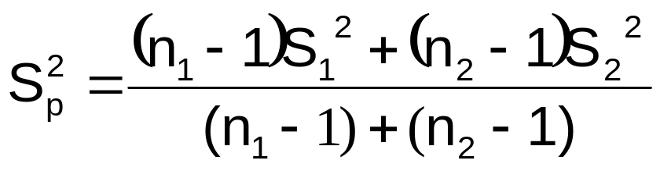
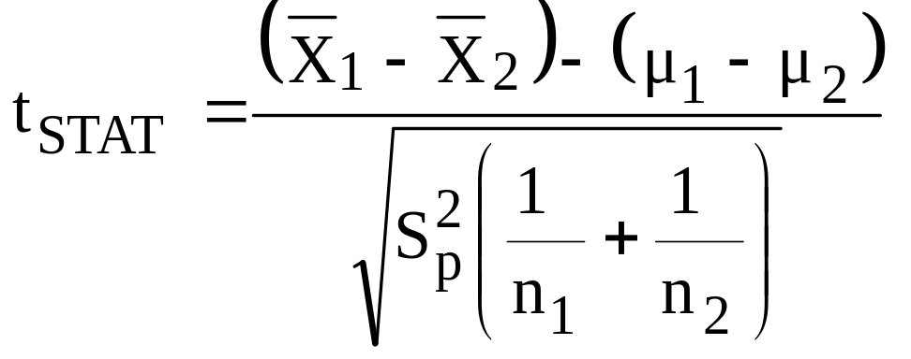
Hypothesis tests for µ₁ - µ₂ with σ₁ and σ₂ unknown and assumed equal
(continued)
The pooled variance is:
The test statistic is:
Where t_{STAT} has d.f. = (n₁ + n₂ – 2)
Population means, independent samples
*
σ₁ and σ₂ unknown, assumed equal
σ₁ and σ₂ unknown, not assumed equal
Basic Business Statistics, 11e © 2009 Prentice-Hall, Inc..
Chap 10-<number>

Slide 10
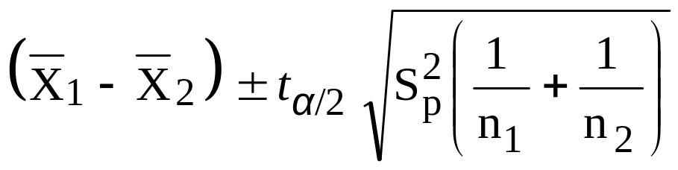
Confidence interval for µ₁ - µ₂ with σ₁ and σ₂ unknown and assumed equal
Population means, independent samples
The confidence interval for
μ₁ – μ₂ is:
Where t_{α/2} has d.f. = n₁ + n₂ – 2
*
σ₁ and σ₂ unknown, assumed equal
σ₁ and σ₂ unknown, not assumed equal
Basic Business Statistics, 11e © 2009 Prentice-Hall, Inc..
Chap 10-<number>

Slide 11

Pooled-Variance t Test Example
You are a financial analyst for a brokerage firm. Is there a difference in dividend yield between stocks listed on the NYSE & NASDAQ? You collect the following data:
NYSE NASDAQ
Number 21 25
Sample mean 3.27 2.53
Sample std dev 1.30 1.16
Assuming both populations are
approximately normal with equal variances, is
there a difference in mean
yield (α = 0.05)?
Basic Business Statistics, 11e © 2009 Prentice-Hall, Inc..
Chap 10-<number>

Slide 12
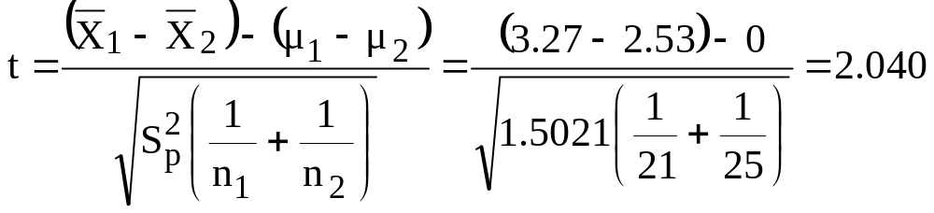
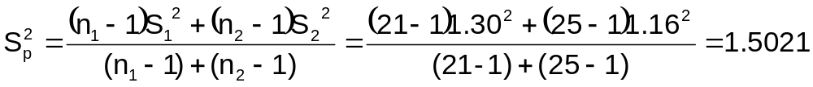
Pooled-Variance t Test Example: Calculating the Test Statistic
(continued)
H0: μ₁ - μ₂ = 0 i.e. (μ₁ = μ₂)
H1: μ₁ - μ₂ ≠ 0 i.e. (μ₁ ≠ μ₂)
The test statistic is:
Basic Business Statistics, 11e © 2009 Prentice-Hall, Inc..
Chap 10-<number>

Slide 13
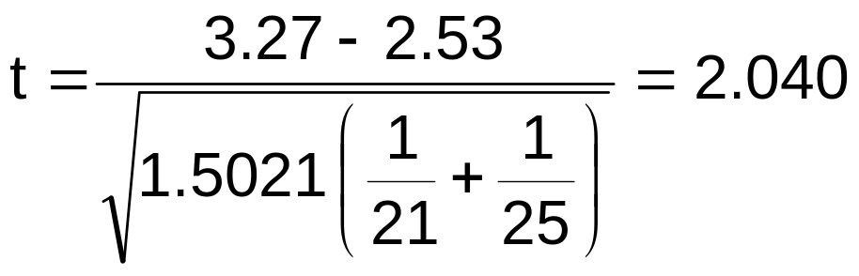
Pooled-Variance t Test Example: Hypothesis Test Solution
H₀: μ₁ - μ₂ = 0 i.e. (μ₁ = μ₂)
H₁: μ₁ - μ₂ ≠ 0 i.e. (μ₁ ≠ μ₂)
α = 0.05
df = 21 + 25 - 2 = 44
Critical Values: t = ± 2.0154
Test Statistic:
Reject H₀
Reject H₀
.025
.025
-2.0154
0
2.0154
t
2.040
Decision:
Conclusion:
Reject H₀ at α = 0.05
There is evidence of a difference in means.
Basic Business Statistics, 11e © 2009 Prentice-Hall, Inc..
Chap 10-<number>

Slide 14
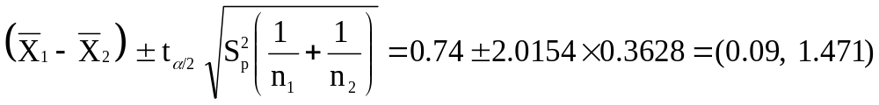
Pooled-Variance t Test Example: Confidence Interval for µ₁ - µ₂
Since we rejected H₀ can we be 95% confident that µ_{NYSE} > µ_{NASDAQ}?
95% Confidence Interval for µ_{NYSE} - µ_{NASDAQ}
Since 0 is less than the entire interval, we can be 95% confident that µ_{NYSE} > µ_{NASDAQ}
Basic Business Statistics, 11e © 2009 Prentice-Hall, Inc..
Chap 10-<number>

Slide 15
Hypothesis tests for µ₁ - µ₂ with σ₁ and σ₂ unknown, not assumed equal
Population means, independent samples
Assumptions:
Samples are randomly and
independently drawn
Populations are normally
distributed or both sample
sizes are at least 30
Population variances are
unknown and cannot be
assumed to be equal
σ₁ and σ₂ unknown, assumed equal
*
σ₁ and σ₂ unknown, not assumed equal
Basic Business Statistics, 11e © 2009 Prentice-Hall, Inc..
Chap 10-<number>

Slide 16
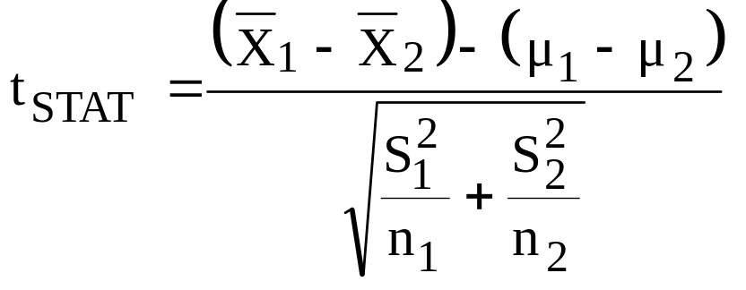
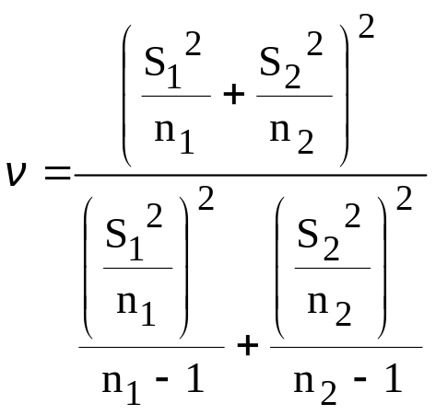
Hypothesis tests for µ₁ - µ₂ with σ₁ and σ₂ unknown and not assumed equal
(continued)
The test statistic is:
Population means, independent samples
σ₁ and σ₂ unknown, assumed equal
t_{STAT} has d.f. ν =
*
σ₁ and σ₂ unknown, not assumed equal
Basic Business Statistics, 11e © 2009 Prentice-Hall, Inc..
Chap 10-<number>

Slide 17
Related Populations
The Paired Difference Test
Tests Means of 2 Related Populations
      Paired or matched samples
      Repeated measures (before/after)
      Use difference between paired values:
Eliminates Variation Among Subjects
Assumptions:
  Both Populations Are Normally Distributed
  Or, if not Normal, use large samples
Related samples
  D_{i} = X_{1i} - X_{2i}
Basic Business Statistics, 11e © 2009 Prentice-Hall, Inc..
Chap 10-<number>

Slide 18
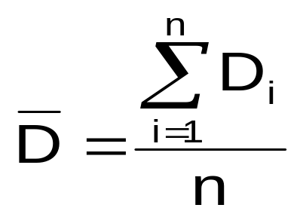
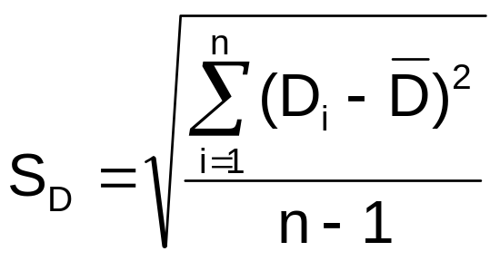
Related Populations
The Paired Difference Test
(continued)
The i^{th} paired difference is D_{i} , where
Related samples
  D_{i} = X_{1i} - X_{2i}
The point estimate for the paired difference population mean μ_{D} is D :
The sample standard deviation is S_{D}
n is the number of pairs in the paired sample
Basic Business Statistics, 11e © 2009 Prentice-Hall, Inc..
Chap 10-<number>

Slide 19
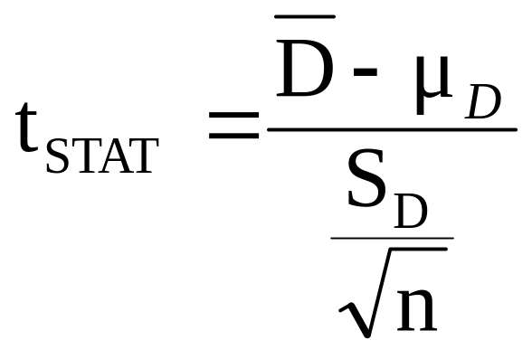
The Paired Difference Test:
Finding t_{STAT}
The test statistic for μ_{D} is:
Paired samples
Where t_{STAT} has n - 1 d.f.
Basic Business Statistics, 11e © 2009 Prentice-Hall, Inc..
Chap 10-<number>

Slide 20
The Paired Difference Test: Possible Hypotheses
Paired Samples
Lower-tail test:
H₀: μ_{D} ≥ 0
H₁: μ_{D} < 0
Upper-tail test:
H₀: μ_{D} ≤ 0
H₁: μ_{D} > 0
Two-tail test:
H₀: μ_{D} = 0
H₁: μ_{D} ≠ 0
α
α
α/2
α/2
-t_{α}
t_{α}
-t_{α/2}
t_{α/2}
Reject H₀ if t_{STAT} < -t_{α}
Reject H₀ if t_{STAT} > t_{α}
Reject H₀ if t_{STAT} < -t_{α/2}
or t_{STAT} > t_{α/2}
Where t_{STAT} has n - 1 d.f.
Basic Business Statistics, 11e © 2009 Prentice-Hall, Inc..
Chap 10-<number>

Slide 21
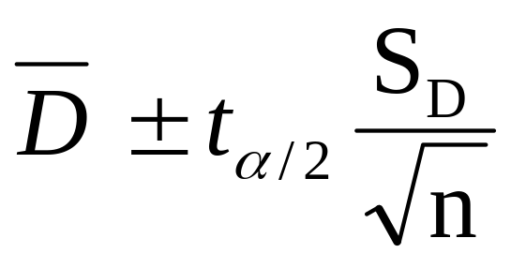
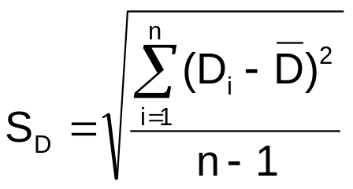
The Paired Difference Confidence Interval
The confidence interval for μ_{D} is
Paired samples
where
Basic Business Statistics, 11e © 2009 Prentice-Hall, Inc..
Chap 10-<number>

Slide 22
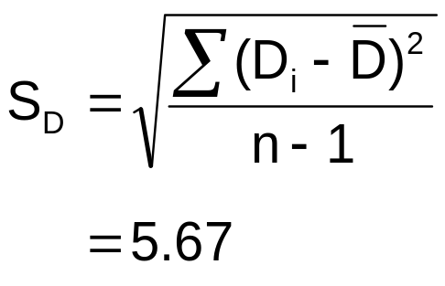
Paired Difference Test: Example
Assume you send your salespeople to a “customer service” training workshop. Has the training made a difference in the number of complaints? You collect the following data:
Number of Complaints: (2) - (1)
Salesperson Before (1) After (2) Difference, D_{i}
C.B. 6 4 - 2
T.F. 20 6 -14
M.H. 3 2 - 1
R.K. 0 0 0
M.O. 4 0 - 4
-21
Σ
D_{i}
D =
n
= -4.2
Basic Business Statistics, 11e © 2009 Prentice-Hall, Inc..
Chap 10-<number>

Slide 23
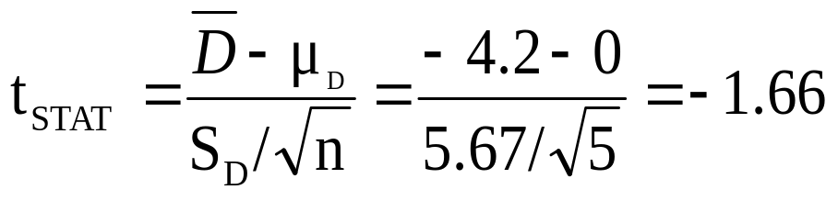
Paired Difference Test: Solution
Has the training made a difference in the number of complaints (at the 0.01 level)?
Reject
Reject
H₀: μ_{D} = 0
H₁: μ_{D} ≠ 0
α/2
α/2
α = .01
D =
- 4.2
- 4.604 4.604
- 1.66
t_{0.005} = ± 4.604 d.f. = n - 1 = 4
Decision: Do not reject H₀
(t_{stat} is not in the reject region)
Test Statistic:
Conclusion: There is not a significant change in the number of complaints.
Basic Business Statistics, 11e © 2009 Prentice-Hall, Inc..
Chap 10-<number>

Slide 24
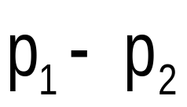
Two Population Proportions
Goal: test a hypothesis or form a confidence interval for the difference between two population proportions, π₁ – π₂
Population proportions
Assumptions:
n₁ π₁ ≥ 5 , n₁(1- π₁) ≥ 5
n₂ π₂ ≥ 5 , n₂(1- π₂) ≥ 5
The point estimate for the difference is
Basic Business Statistics, 11e © 2009 Prentice-Hall, Inc..
Chap 10-<number>

Slide 25
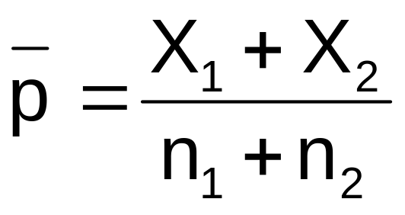
Two Population Proportions
In the null hypothesis we assume the null hypothesis is true, so we assume π₁ = π₂ and pool the two sample estimates
Population proportions
The pooled estimate for the overall proportion is:
where X₁ and X₂ are the number of items of interest in samples 1 and 2
Basic Business Statistics, 11e © 2009 Prentice-Hall, Inc..
Chap 10-<number>

Slide 26
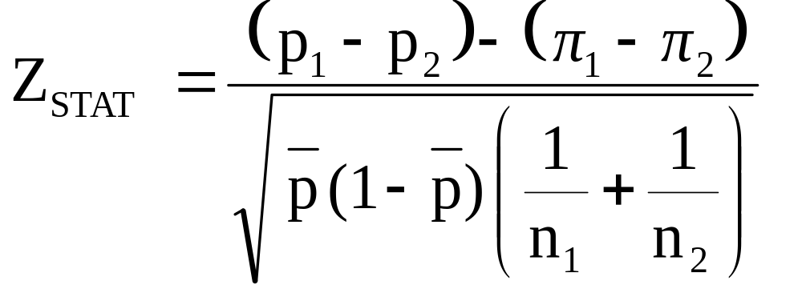
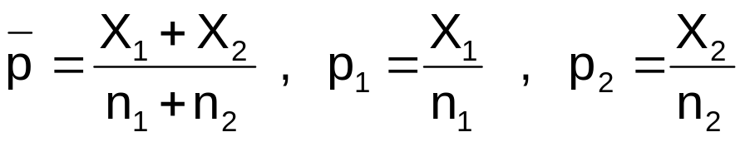
Two Population Proportions
(continued)
The test statistic for
π₁ – π₂ is a Z statistic:
Population proportions
where
Basic Business Statistics, 11e © 2009 Prentice-Hall, Inc..
Chap 10-<number>

Slide 27
Hypothesis Tests for
Two Population Proportions
Population proportions
Lower-tail test:
H₀: π₁ ≥ π₂
H₁: π₁ < π₂
i.e.,
H₀: π₁ – π₂ ≥ 0
H₁: π₁ – π₂ < 0
Upper-tail test:
H₀: π₁ ≤ π₂
H₁: π₁ > π₂
i.e.,
H₀: π₁ – π₂ ≤ 0
H₁: π₁ – π₂ > 0
Two-tail test:
H₀: π₁ = π₂
H₁: π₁ ≠ π₂
i.e.,
H₀: π₁ – π₂ = 0
H₁: π₁ – π₂ ≠ 0
Basic Business Statistics, 11e © 2009 Prentice-Hall, Inc..
Chap 10-<number>

Slide 28
Hypothesis Tests for
Two Population Proportions
(continued)
Population proportions
Lower-tail test:
H₀: π₁ – π₂ ≥ 0
H₁: π₁ – π₂ < 0
Upper-tail test:
H₀: π₁ – π₂ ≤ 0
H₁: π₁ – π₂ > 0
Two-tail test:
H₀: π₁ – π₂ = 0
H₁: π₁ – π₂ ≠ 0
α
α
α/2
α/2
-z_{α}
z_{α}
-z_{α/2}
z_{α/2}
Reject H₀ if Z_{STAT} < -Z_{α}
Reject H₀ if Z_{STAT} > Z_{α}
Reject H₀ if Z_{STAT} < -Z_{α/2}
or Z_{STAT} > Z_{α/2}
Basic Business Statistics, 11e © 2009 Prentice-Hall, Inc..
Chap 10-<number>

Slide 29

Hypothesis Test Example:
Two population Proportions
Is there a significant difference between the proportion of men and the proportion of women who will vote Yes on Proposition A?
In a random sample, 36 of 72 men and 31 of 50 women indicated they would vote Yes
Test at the .05 level of significance
Basic Business Statistics, 11e © 2009 Prentice-Hall, Inc..
Chap 10-<number>

Slide 30
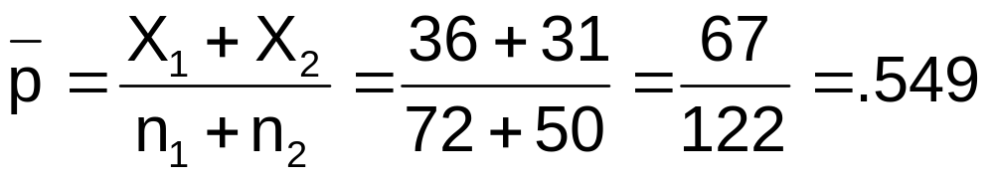
Hypothesis Test Example:
Two population Proportions
(continued)
The hypothesis test is:
H₀: π₁ – π₂ = 0 (the two proportions are equal)
H₁: π₁ – π₂ ≠ 0 (there is a significant difference between proportions)
The sample proportions are:
  Men: p₁ = 36/72 = .50
  Women: p₂ = 31/50 = .62
The pooled estimate for the overall proportion is:
Basic Business Statistics, 11e © 2009 Prentice-Hall, Inc..
Chap 10-<number>

Slide 31
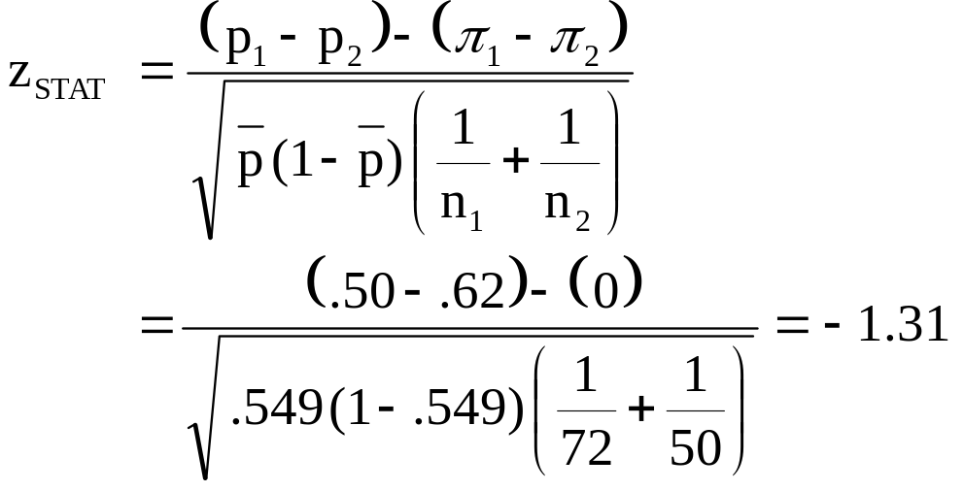
Hypothesis Test Example:
Two population Proportions
(continued)
Reject H₀
Reject H₀
The test statistic for π₁ – π₂ is:
.025
.025
-1.96
1.96
-1.31
Decision: Do not reject H₀
Conclusion: There is not significant evidence of a difference in proportions who will vote yes between men and women.
Critical Values = ±1.96
For α = .05
Basic Business Statistics, 11e © 2009 Prentice-Hall, Inc..
Chap 10-<number>

Slide 32
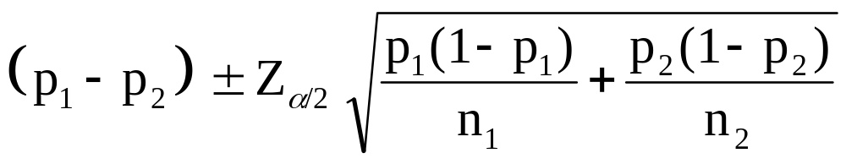
Confidence Interval for
Two Population Proportions
Population proportions
The confidence interval for
π₁ – π₂ is:
Basic Business Statistics, 11e © 2009 Prentice-Hall, Inc..
Chap 10-<number>

Slide 33
Hypothesis Tests for Variances
Hypotheses F_{STAT}
*
Tests for Two
Population
Variances
H₀: σ₁² = σ₂²
H₁: σ₁² ≠ σ₂²
S₁² / S₂²
H₀: σ₁² ≤ σ₂²
H₁: σ₁² > σ₂²
F test statistic
Where:
S₁² = Variance of sample 1 (the larger sample variance)
n₁ = sample size of sample 1
S₂² = Variance of sample 2 (the smaller sample variance)
n₂ = sample size of sample 2
n₁ –1 = numerator degrees of freedom
n₂ – 1 = denominator degrees of freedom
Basic Business Statistics, 11e © 2009 Prentice-Hall, Inc..
Chap 10-<number>

Slide 34
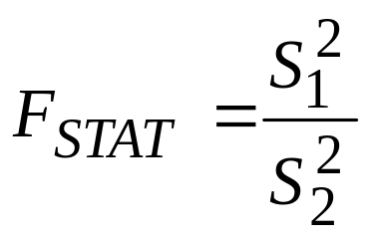
The F Distribution
The F critical value is found from the F table
There are two degrees of freedom required: numerator and denominator
When
In the F table,
  numerator degrees of freedom determine the column
  denominator degrees of freedom determine the row
df₁ = n₁ – 1 ; df₂ = n₂ – 1
Basic Business Statistics, 11e © 2009 Prentice-Hall, Inc..
Chap 10-<number>

Slide 35
Finding the Rejection Region
H₀: σ₁² = σ₂²
H₁: σ₁² ≠ σ₂²
H₀: σ₁² ≤ σ₂²
H₁: σ₁² > σ₂²
α/2
F
α
0
0
F
Do not
reject H₀
F_{α/2}
Reject H₀
Do not
reject H₀
F_{α}
Reject H₀
Reject H₀ if F_{STAT} > F_{α/2}
Reject H₀ if F_{STAT} > F_{α}
Basic Business Statistics, 11e © 2009 Prentice-Hall, Inc..
Chap 10-<number>

Slide 36
F Test: An Example
You are a financial analyst for a brokerage firm. You want to compare dividend yields between stocks listed on the NYSE & NASDAQ. You collect the following data:
NYSE NASDAQ
Number 21 25
Mean 3.27 2.53
Std dev 1.30 1.16
Is there a difference in the variances between the NYSE & NASDAQ at the α = 0.05 level?
Basic Business Statistics, 11e © 2009 Prentice-Hall, Inc..
Chap 10-<number>

Slide 37
F Test: Example Solution
Form the hypothesis test:
  H₀: σ²₁ = σ²₂ (there is no difference between variances)
  H₁: σ²₁ ≠ σ²₂ (there is a difference between variances)
Find the F critical value for α = 0.05:
Numerator d.f. = n₁ – 1 = 21 –1 =20
Denominator d.f. = n2 – 1 = 25 –1 = 24
F_{α/2} = F_{.025, 20, 24} = 2.33
Basic Business Statistics, 11e © 2009 Prentice-Hall, Inc..
Chap 10-<number>

Slide 38
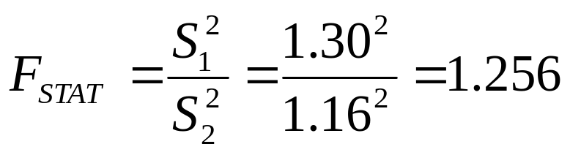
F Test: Example Solution
(continued)
The test statistic is:
H₀: σ₁² = σ₂²
H₁: σ₁² ≠ σ₂²
α/2 = .025
0
F
Do not
reject H₀
Reject H₀
F_{STAT} = 1.256 is not in the rejection region, so we do not reject H₀
F_{0.025}=2.33
Conclusion: There is not sufficient evidence of a difference in variances at α = .05
Basic Business Statistics, 11e © 2009 Prentice-Hall, Inc..
Chap 10-<number>

Slide 39
Chapter Summary
Compared two independent samples
  Performed pooled-variance t test for the difference in two means
  Performed separate-variance t test for difference in two means
  Formed confidence intervals for the difference between two means
Compared two related samples (paired samples)
  Performed paired t test for the mean difference
  Formed confidence intervals for the mean difference
Basic Business Statistics, 11e © 2009 Prentice-Hall, Inc..
Chap 10-<number>

Slide 40
Chapter Summary
(continued)
Compared two population proportions
  Formed confidence intervals for the difference between two population proportions
  Performed Z-test for two population proportions
Performed F test for the difference between two population variances
Basic Business Statistics, 11e © 2009 Prentice-Hall, Inc..
Chap 10-<number>

